Slide 1




Bakery Sales Prediction
Introduction to Data Science and Machine Learning
Group 3
Georgia Avgerinou Anton Röfer
Kiel, July 2025

Slide 2

Goal: to predict sales for 6 bakery product categories

Slide 3
Additional variables
From given data:
Day of the week
Weekend
New Years Eve
Is Saturday
Is Sunday
Days until NYE
Group 6 Season Score
From external data:
School holidays
Public Holidays
Voting Days
VPI (Consumer Price Index )
Precipitation
Dataset Characteristics – Baseline Model – Neural Net – Challenges

Slide 4
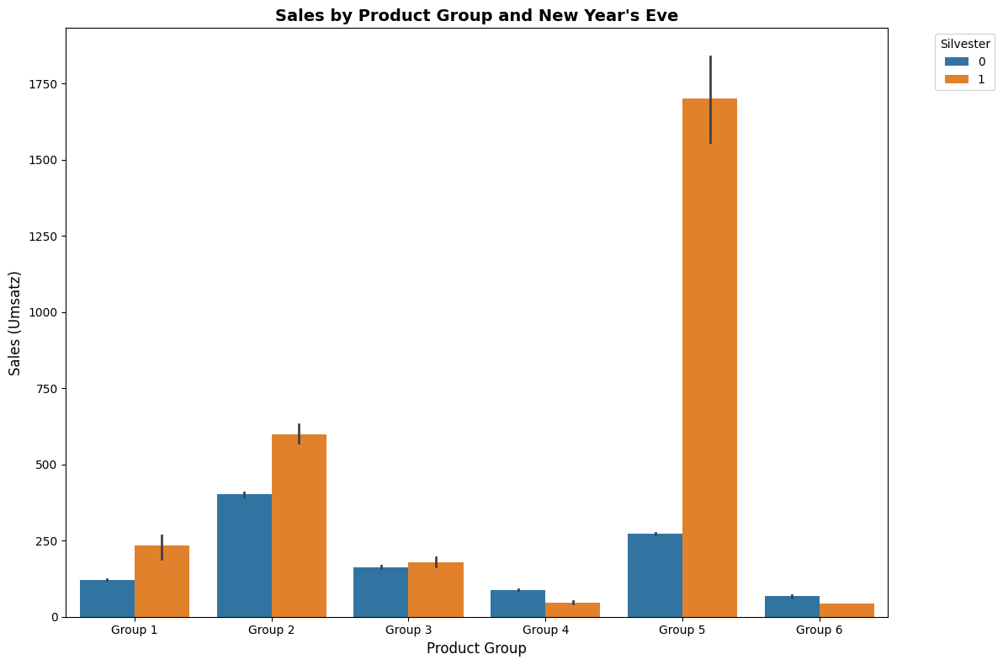
Additional variables
Dataset Characteristics – Baseline Model – Neural Net – Challenges
Notes:
# Create the barplot with confidence intervals
plt.figure(figsize=(10, 6))
sns.barplot(data=group6_data, x='seasonal_score2', y='Umsatz', ci=95)
# Customize the plot
plt.title('Group 6 Sales by Seasonal Score', fontsize=14, fontweight='bold')
plt.xlabel('Seasonal Score', fontsize=12)
plt.ylabel('Sales (Umsatz)', fontsize=12)
plt.xticks(rotation=0)
# Adjust layout to prevent label cutoff
plt.tight_layout()
# Show the plot
plt.show()
data = data.drop(columns=cols_to_remove)
import pandas as pd
import seaborn as sns
import matplotlib.pyplot as plt
# Assuming your data is in a DataFrame called 'data'
# Melt data to have all groups in one plot for Silvester variable
melted_data = []
for i in range(1, 7): # Assuming 6 groups like your example
# Filter data for current group
group_data = data[data[f'Warengruppe_{i}'] == 1].copy()
group_data['Product_Group'] = f'Group {i}'
# Select relevant columns including Silvester
# Adjust column names based on your actual data structure
melted_data.append(group_data[['Silvester', 'Umsatz', 'Product_Group']])
# Combine all group data
combined_data = pd.concat(melted_data, ignore_index=True)
# Create the plot
plt.figure(figsize=(12, 8))
# Create grouped barplot with confidence intervals
ax = sns.barplot(data=combined_data,
x='Product_Group',
y='Umsatz',
hue='Silvester',
ci=95, # 95% confidence interval
# Cap size for error bars
errwidth=2) # Width of error bars
# Customize the plot
plt.title('Sales by Product Group and New Year\'s Eve',
fontsize=14, fontweight='bold')
plt.xlabel('Product Group', fontsize=12)
plt.ylabel('Sales (Umsatz)', fontsize=12)
plt.legend(title='Silvester', bbox_to_anchor=(1.05, 1), loc='upper left')
# Rotate x-axis labels if needed
plt.xticks(rotation=0)
# Adjust layout to prevent label cutoff
plt.tight_layout()
# Display the plot
plt.show()

Slide 5
Additional variables
Dataset Characteristics – Baseline Model – Neural Net – Challenges
Notes:
# Create the barplot with confidence intervals
plt.figure(figsize=(10, 6))
sns.barplot(data=group6_data, x='seasonal_score2', y='Umsatz', ci=95)
# Customize the plot
plt.title('Group 6 Sales by Seasonal Score', fontsize=14, fontweight='bold')
plt.xlabel('Seasonal Score', fontsize=12)
plt.ylabel('Sales (Umsatz)', fontsize=12)
plt.xticks(rotation=0)
# Adjust layout to prevent label cutoff
plt.tight_layout()
# Show the plot
plt.show()
data = data.drop(columns=cols_to_remove)
import pandas as pd
import seaborn as sns
import matplotlib.pyplot as plt
# Assuming your data is in a DataFrame called 'data'
# Melt data to have all groups in one plot for Silvester variable
melted_data = []
for i in range(1, 7): # Assuming 6 groups like your example
# Filter data for current group
group_data = data[data[f'Warengruppe_{i}'] == 1].copy()
group_data['Product_Group'] = f'Group {i}'
# Select relevant columns including Silvester
# Adjust column names based on your actual data structure
melted_data.append(group_data[['Silvester', 'Umsatz', 'Product_Group']])
# Combine all group data
combined_data = pd.concat(melted_data, ignore_index=True)
# Create the plot
plt.figure(figsize=(12, 8))
# Create grouped barplot with confidence intervals
ax = sns.barplot(data=combined_data,
x='Product_Group',
y='Umsatz',
hue='Silvester',
ci=95, # 95% confidence interval
# Cap size for error bars
errwidth=2) # Width of error bars
# Customize the plot
plt.title('Sales by Product Group and New Year\'s Eve',
fontsize=14, fontweight='bold')
plt.xlabel('Product Group', fontsize=12)
plt.ylabel('Sales (Umsatz)', fontsize=12)
plt.legend(title='Silvester', bbox_to_anchor=(1.05, 1), loc='upper left')
# Rotate x-axis labels if needed
plt.xticks(rotation=0)
# Adjust layout to prevent label cutoff
plt.tight_layout()
# Display the plot
plt.show()

Slide 6
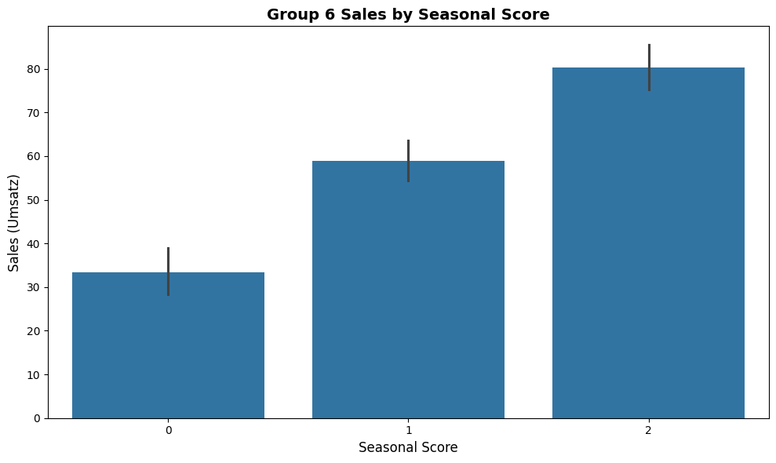
Additional variables
Dataset Characteristics – Baseline Model – Neural Net – Challenges
Notes:
Seasonal score 2= December 1= November 0=anything else
# Create the barplot with confidence intervals
plt.figure(figsize=(10, 6))
sns.barplot(data=group6_data, x='seasonal_score2', y='Umsatz', ci=95)
# Customize the plot
plt.title('Group 6 Sales by Seasonal Score', fontsize=14, fontweight='bold')
plt.xlabel('Seasonal Score', fontsize=12)
plt.ylabel('Sales (Umsatz)', fontsize=12)
plt.xticks(rotation=0)
# Adjust layout to prevent label cutoff
plt.tight_layout()
# Show the plot
plt.show()
data = data.drop(columns=cols_to_remove)
import pandas as pd
import seaborn as sns
import matplotlib.pyplot as plt
# Assuming your data is in a DataFrame called 'data'
# Melt data to have all groups in one plot for Silvester variable
melted_data = []
for i in range(1, 7): # Assuming 6 groups like your example
# Filter data for current group
group_data = data[data[f'Warengruppe_{i}'] == 1].copy()
group_data['Product_Group'] = f'Group {i}'
# Select relevant columns including Silvester
# Adjust column names based on your actual data structure
melted_data.append(group_data[['Silvester', 'Umsatz', 'Product_Group']])
# Combine all group data
combined_data = pd.concat(melted_data, ignore_index=True)
# Create the plot
plt.figure(figsize=(12, 8))
# Create grouped barplot with confidence intervals
ax = sns.barplot(data=combined_data,
x='Product_Group',
y='Umsatz',
hue='Silvester',
ci=95, # 95% confidence interval
# Cap size for error bars
errwidth=2) # Width of error bars
# Customize the plot
plt.title('Sales by Product Group and New Year\'s Eve',
fontsize=14, fontweight='bold')
plt.xlabel('Product Group', fontsize=12)
plt.ylabel('Sales (Umsatz)', fontsize=12)
plt.legend(title='Silvester', bbox_to_anchor=(1.05, 1), loc='upper left')
# Rotate x-axis labels if needed
plt.xticks(rotation=0)
# Adjust layout to prevent label cutoff
plt.tight_layout()
# Display the plot
plt.show()

Slide 7
Additional variables
Dataset Characteristics – Baseline Model – Neural Net – Challenges
Notes:
# Create the barplot with confidence intervals
plt.figure(figsize=(10, 6))
sns.barplot(data=group6_data, x='seasonal_score2', y='Umsatz', ci=95)
# Customize the plot
plt.title('Group 6 Sales by Seasonal Score', fontsize=14, fontweight='bold')
plt.xlabel('Seasonal Score', fontsize=12)
plt.ylabel('Sales (Umsatz)', fontsize=12)
plt.xticks(rotation=0)
# Adjust layout to prevent label cutoff
plt.tight_layout()
# Show the plot
plt.show()
data = data.drop(columns=cols_to_remove)
import pandas as pd
import seaborn as sns
import matplotlib.pyplot as plt
# Assuming your data is in a DataFrame called 'data'
# Melt data to have all groups in one plot for Silvester variable
melted_data = []
for i in range(1, 7): # Assuming 6 groups like your example
# Filter data for current group
group_data = data[data[f'Warengruppe_{i}'] == 1].copy()
group_data['Product_Group'] = f'Group {i}'
# Select relevant columns including Silvester
# Adjust column names based on your actual data structure
melted_data.append(group_data[['Silvester', 'Umsatz', 'Product_Group']])
# Combine all group data
combined_data = pd.concat(melted_data, ignore_index=True)
# Create the plot
plt.figure(figsize=(12, 8))
# Create grouped barplot with confidence intervals
ax = sns.barplot(data=combined_data,
x='Product_Group',
y='Umsatz',
hue='Silvester',
ci=95, # 95% confidence interval
# Cap size for error bars
errwidth=2) # Width of error bars
# Customize the plot
plt.title('Sales by Product Group and New Year\'s Eve',
fontsize=14, fontweight='bold')
plt.xlabel('Product Group', fontsize=12)
plt.ylabel('Sales (Umsatz)', fontsize=12)
plt.legend(title='Silvester', bbox_to_anchor=(1.05, 1), loc='upper left')
# Rotate x-axis labels if needed
plt.xticks(rotation=0)
# Adjust layout to prevent label cutoff
plt.tight_layout()
# Display the plot
plt.show()

Slide 8
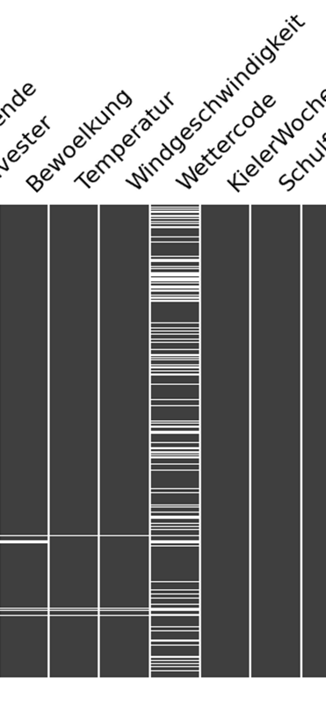
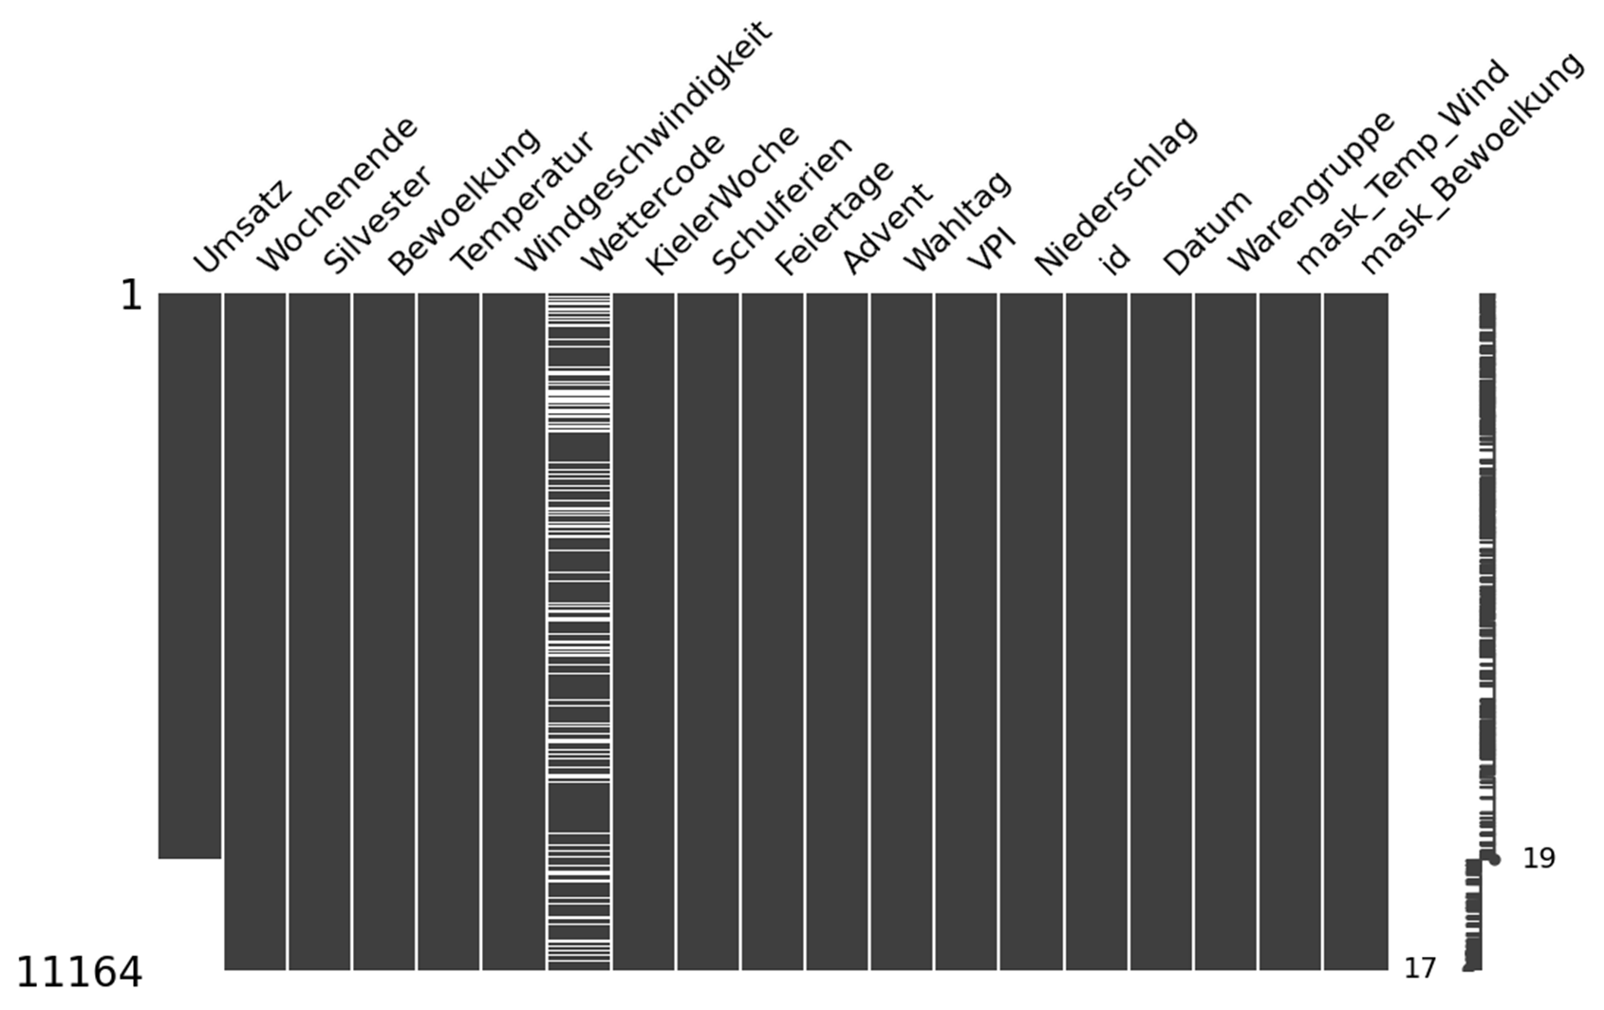


Dealing with missing values
Imputation
Dataset Characteristics – Baseline Model – Neural Net – Challenges
Notes:
Suggestion is to keep only the missing values columns we worked on and next to talk about wetter code
Prev slides saved in the end of the presentation

Slide 9
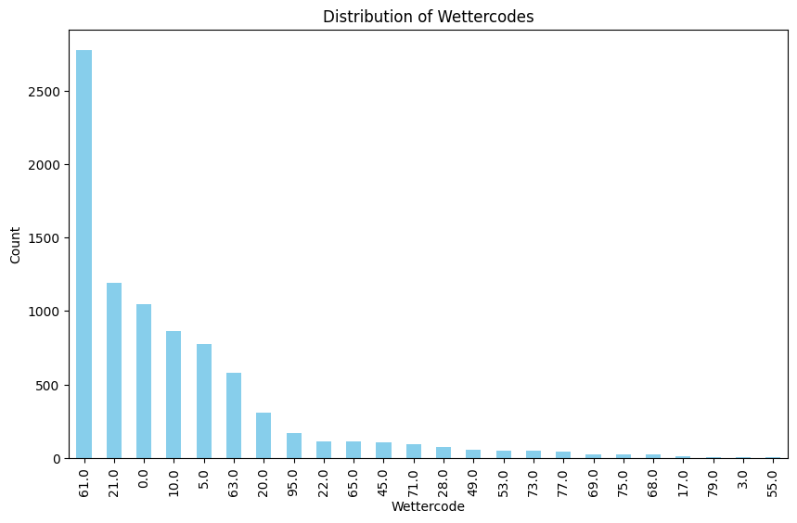

Dealing with missing values
Weather code distribution
One-Hot Encoding
Wettercode_0
Wettercode_5
Wettercode_10
Wettercode_21
Wettercode_61
Wettercode_63
Wettercode_NAN
Wettercode_REST
Dataset Characteristics – Baseline Model – Neural Net – Challenges

Slide 10
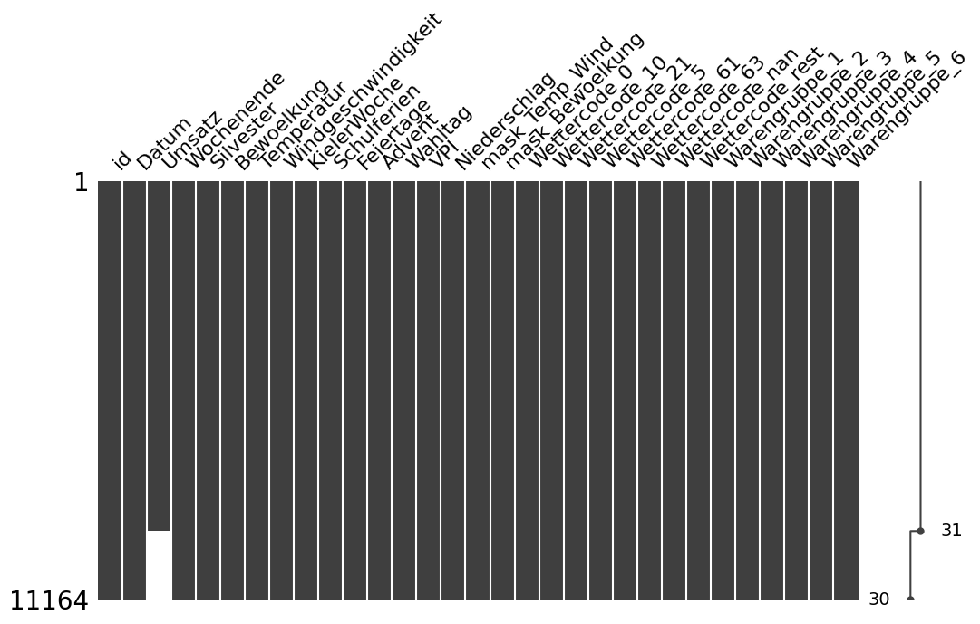
Full dataset
Training
Validation
Test
Dataset Characteristics – Baseline Model – Neural Net – Challenges
Notes:
Full (initial) dataset

Slide 11
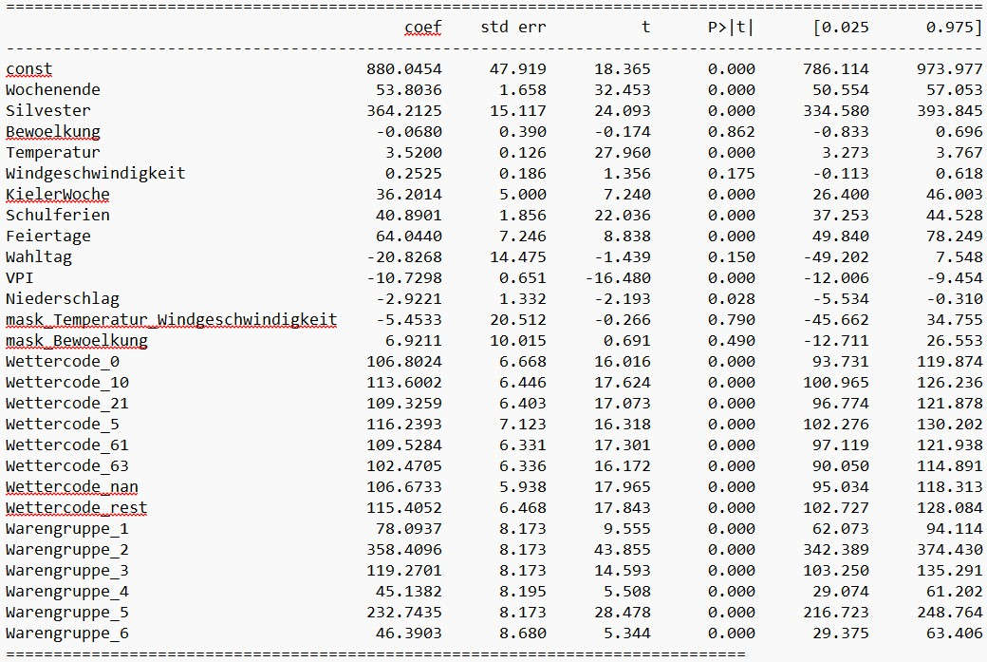
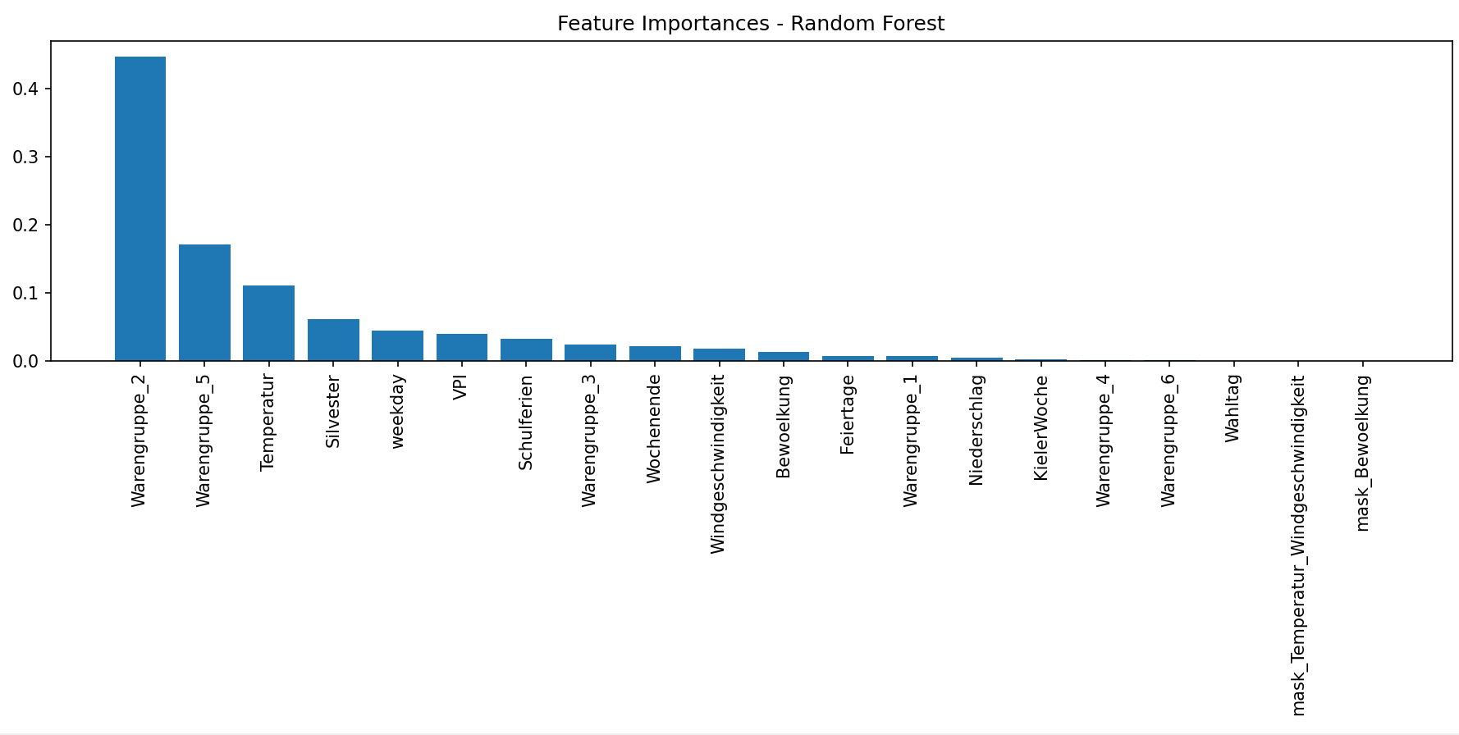
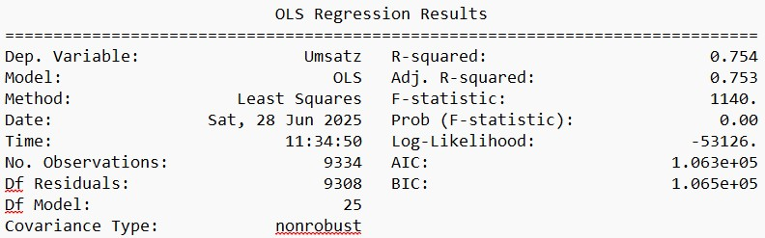
Dataset Characteristics – Baseline Model – Neural Net – Challenges

Slide 12
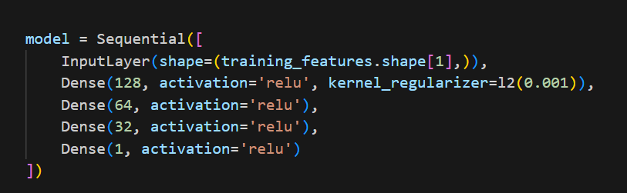
Neural Network
Features:
Temperature
School Holidays
Day of the Week
Days till NYE
+
One Hot encoded sales groups
Dataset Characteristics – Baseline Model – Neural Net – Challenges

Slide 13
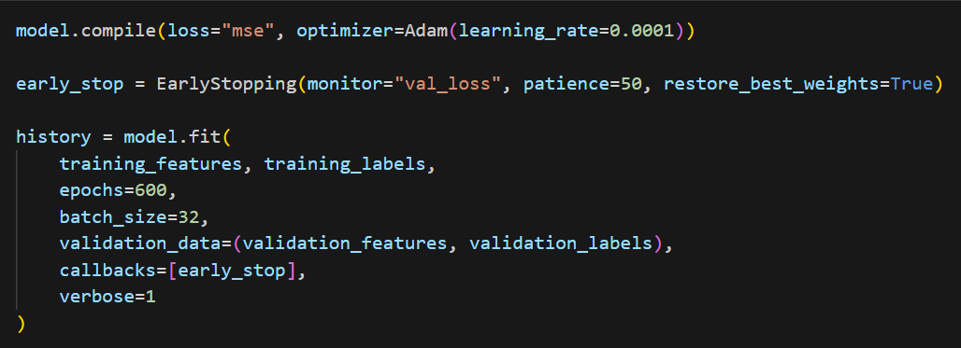
Neural Network
Features:
Temperature
School Holidays
Day of the Week
Days till NYE
+
One Hot encoded sales groups
Dataset Characteristics – Baseline Model – Neural Net – Challenges

Slide 14
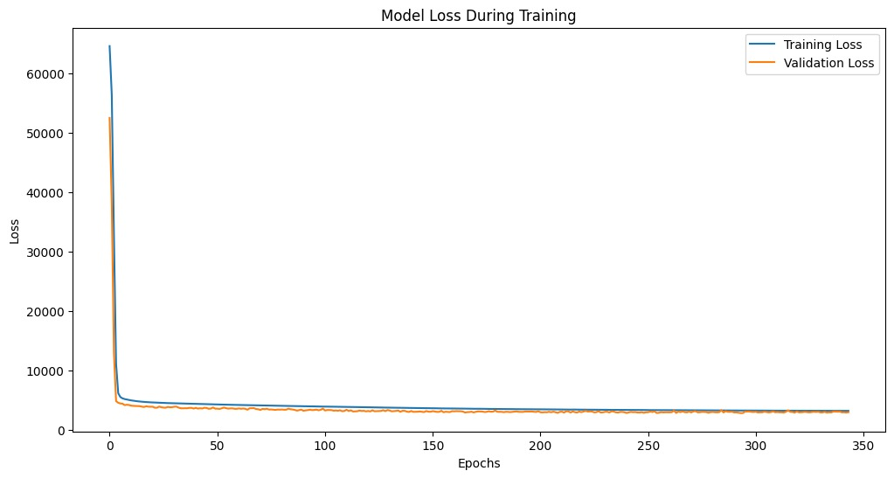

Neural Network
MAPE
Validation Data : 20.28%
0.18081
Dataset Characteristics – Baseline Model – Neural Net – Challenges

Slide 15
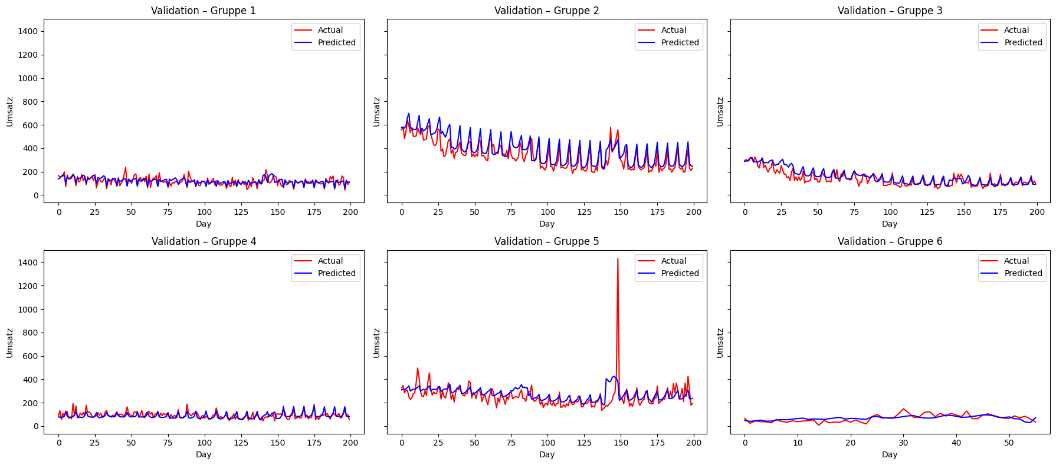
Neural Network – Validation Dataset
Product | MAPE in %
1 | 20.29
2 | 15.52
3 | 19.75
4 | 22.85
5 | 17.95
6 | 50.12
Dataset Characteristics – Baseline Model – Neural Net – Challenges

Slide 16
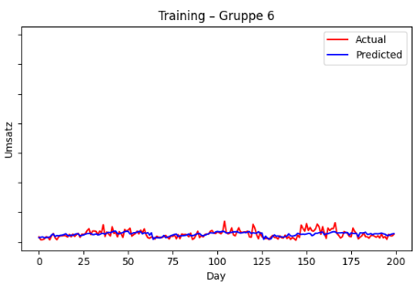
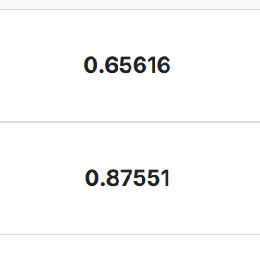
Challenges
Select features & Prevent overfitting
Predict Group 6
Biggest Improvement: Removing variables, simplifying the model
Dataset Characteristics – Baseline Model – Neural Net – Challenges

Slide 17

Thank you!
Questions?
Introduction to Data Science and Machine Learning • SoSe 2025 • Group 3

